Slide 1
Error Report
Mobile System Engineering dept.
MSE
Chang Yoon Lee
ithingscp2
Just for warm up
START

Slide 2
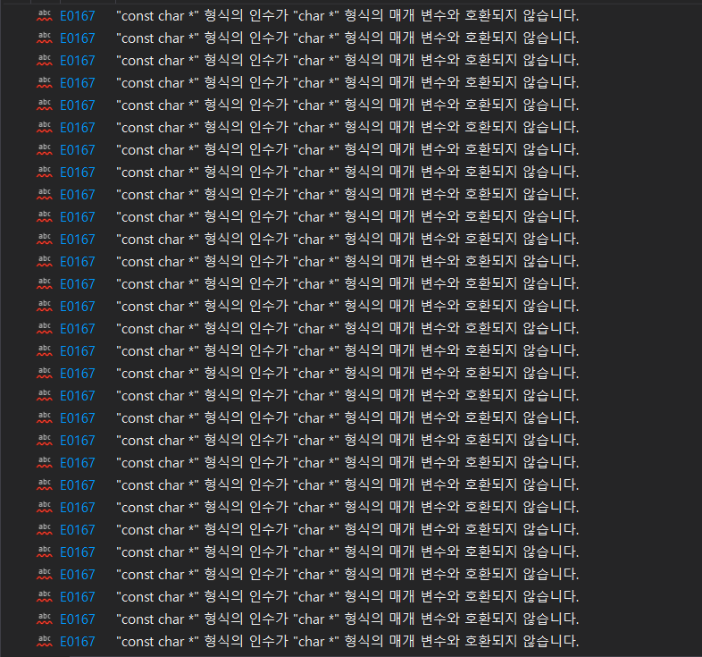
C1
Case 1: Changing the code
Error: E0167
This error occurs because the function ‘gotoxy()’ takes the variable as string.
Those “” sentence forms were given as a constant value.
They don't have a variable assigned to them, so they can't change it.
Therefore, it seems that we should receive the char as a function counter in the form of a constant, i.e. a constant value.

Slide 3
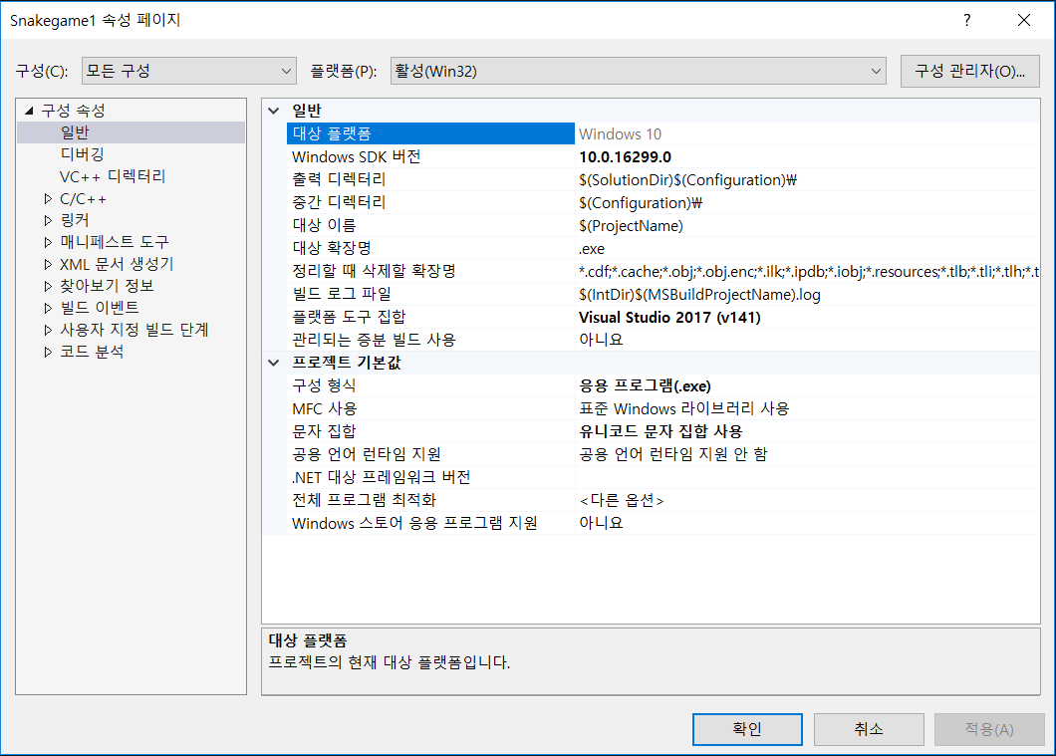
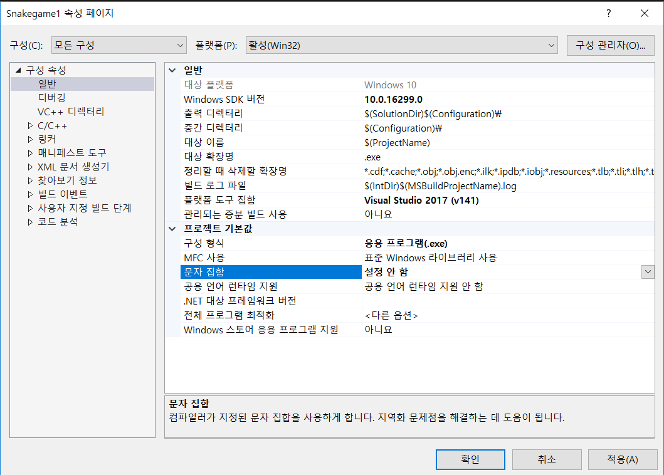
C2
Case 2: Fixing the Option
Error: E0167

Slide 4
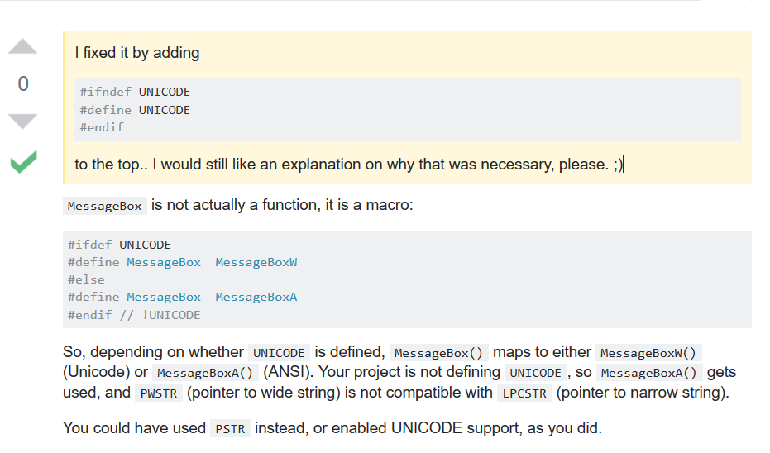
C3
Case 3: Referred by Stack Over Flow
Error: E0167
Actually, Error: E0167 occurs not only for char*. It occurs by Unicode problem.
In short, this solution is as same as the case 2.

Slide 5
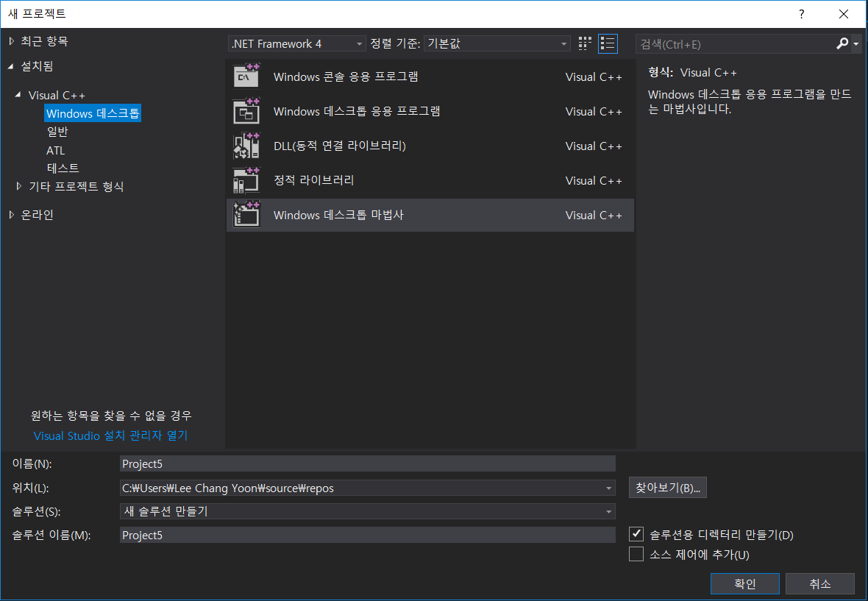
C4
Case 4: Set as a Desktop application
Error: E0167
I do not really know why it does not work on console application, but by googling, I found out what are the difference between console application and windows application.
A Windows form application is an application that has a graphical user interface(GUI) like the Visual C# IDE. A console program on the other hand is a text application. There are not fancy controls like buttons or textboxes in a console application and they are run from the command prompt

